Slide 2
Community Localization
Terry Sheng, Regional Program Manager

Slide 3
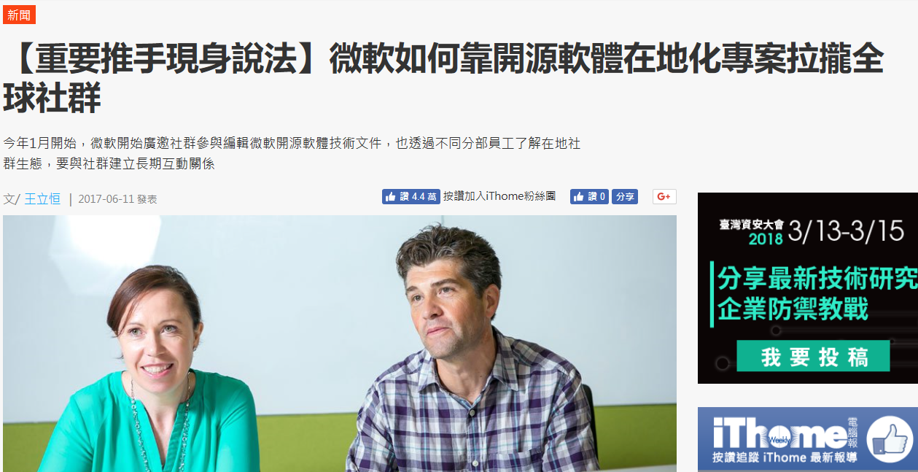

Community Localization
Product Localization
Content Localization
Reference:
https://github.com/Microsoft/localization/wiki (English)
https://www.ithome.com.tw/news/114637 (Chinese)
Notes:
Community Localization is a specific sourcing model, in which we use translation contributions from the community for our product offerings.
It’s distinguished from outsourcing, where we pay a third-party company to procure translation services.
Community Localization is not commissioned from a specific named group and does not involve monetary compensation
https://github.com/Microsoft/localization/wiki
https://www.ithome.com.tw/news/114637

Slide 4
Open Source Product Localization

Slide 5

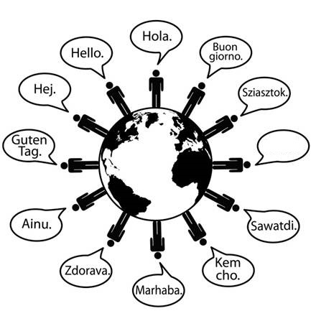






Product Localization
你好

Slide 6

Open Source Product Localization
SQL on Linux Tools
Localized in 10 languages by Communities (including Simplified Chinese)
First General Availability release on May 2nd, 2017 with updates planned every 4 – 6 weeks
VS Code
Localized in 17 languages by Communities (including Simplified Chinese)
First General Availability release May 5th, 2017 with updates planned every 4 weeks
Team Explorer Everywhere
Localized in 9 languages (including Simplified Chinese)
First release in mid February – on demand update cadence
Reference:
http://aka.ms/osscn (Simplified Chinese)
https://github.com/Microsoft/localization/wiki (English)
Notes:
Started from Jan 2017 with 3 Open Sourced projects.
SQL on Linux Tools
Localized in 10 languages (Chinese simplified, Chinese Traditional, French, German, Italian, Japanese, Korean, Portuguese Brazil, Russian, Spanish)
First GA on May 2nd 2017 with updates planned every 4 – 6 weeks
~80 collaborators contributed to this release
VS Code – source code editor developed by Microsoft for Windows, Linus and macOS
Localized in 17 languages (Chinese simplified, Chinese Traditional, French, German, Italian, Japanese, Korean, Russian, Spanish, Czech, Dutch, Hungarian, Polish, Portuguese Brazil, Portuguese, Swedish and Turkish – net new)
First GA release May 5th 2017 with updates planned every 4 weeks
~120 collaborators contributed to this release
Team Explorer Everywhere – official TFS plug-in for Eclipse from Microsoft
Localized in 9 languages (Chinese simplified, Chinese Traditional, French, German, Japanese, Korean, Russian, Spanish – net new)
First release mid February – on demand update cadence
~48 contributors
https://github.com/Microsoft/localization/wiki
General availability (GA) is the marketing stage at which all necessary commercialization activities have been completed and a software product is available for purchase, depending, however, on language, region, electronic vs. media availability. Commercialization activities could include security and compliance tests, as well as localization and worldwide availability. The time between RTM and GA can be from a week to months in some cases before a generally available release can be declared because of the time needed to complete all commercialization activities required by GA. At this stage, the software has "gone live".

Slide 7
How to Participate?

Slide 8
New with Transifex
1. Login to Transifex
2. If you are new with Transifex, you may create an account here or you may login with your GitHub, Google or LinkedIn account
www.transifex.com

Slide 9
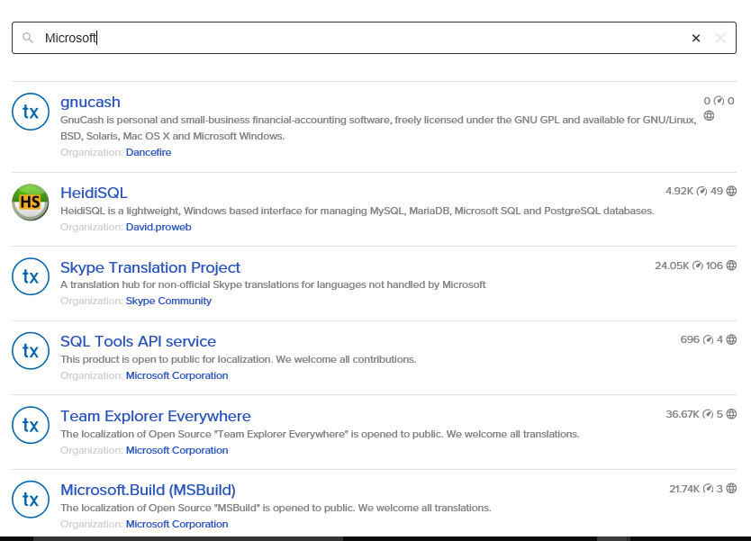
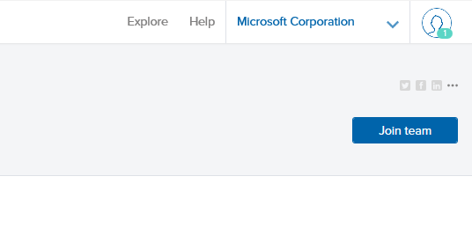
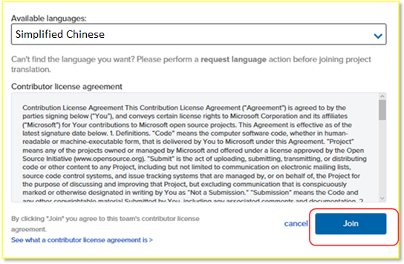
Request for Access
1. Search for Microsoft and the Project Name or you may just go project link directly
2. Click Join team at the upper right corner of the page
3. Select the language you want to contribute to.
Click the Join button.
You will receive a notification within 24 hours if your request is approved.

Slide 10
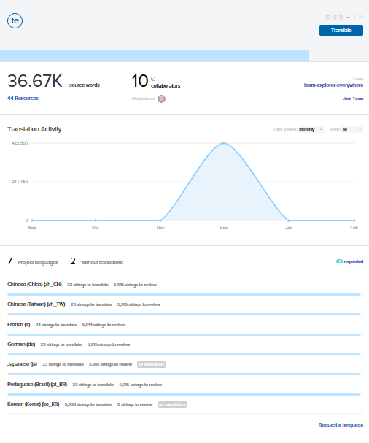
Start Contribution
VSCode
VSCode Editor
VSCode Extensions
VSCode Setup
VSCode Workbench
SQL on Linux Tools
Visual Studio Code SQL Server Extension
SQL Tools API Service
Plug-in for Java Eclipse
Team Explorer Everywhere
1. Go to the Project Links
Select your requested language.
Click Translate
2. If the language you wish to translate is not available, click the Request a language link at the bottom right corner of the page

Slide 11
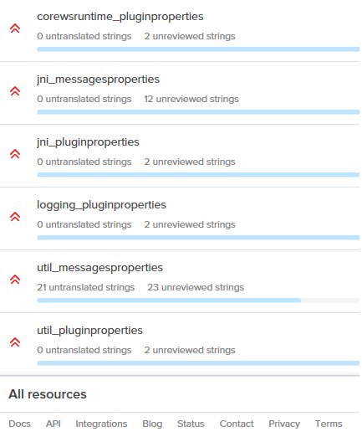
Select a Resource
2. Or select a particular resource in the product.
1. Select All Resources at the bottom of the page.

Slide 12
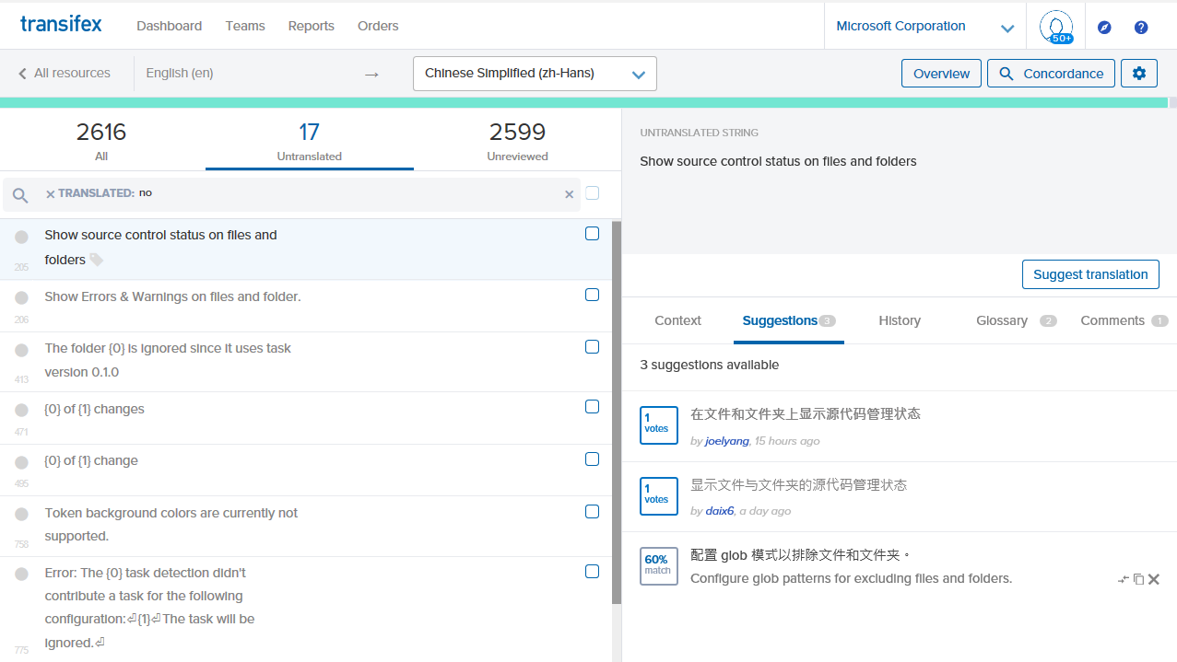
Untranslated Strings
2. If the string is Untranslated, click Suggest translation and you may enter your suggested translation, or vote an existing suggestion
1. You may select a string under the Resources
3. It provides you possible suggested translation to adopt.

Slide 13
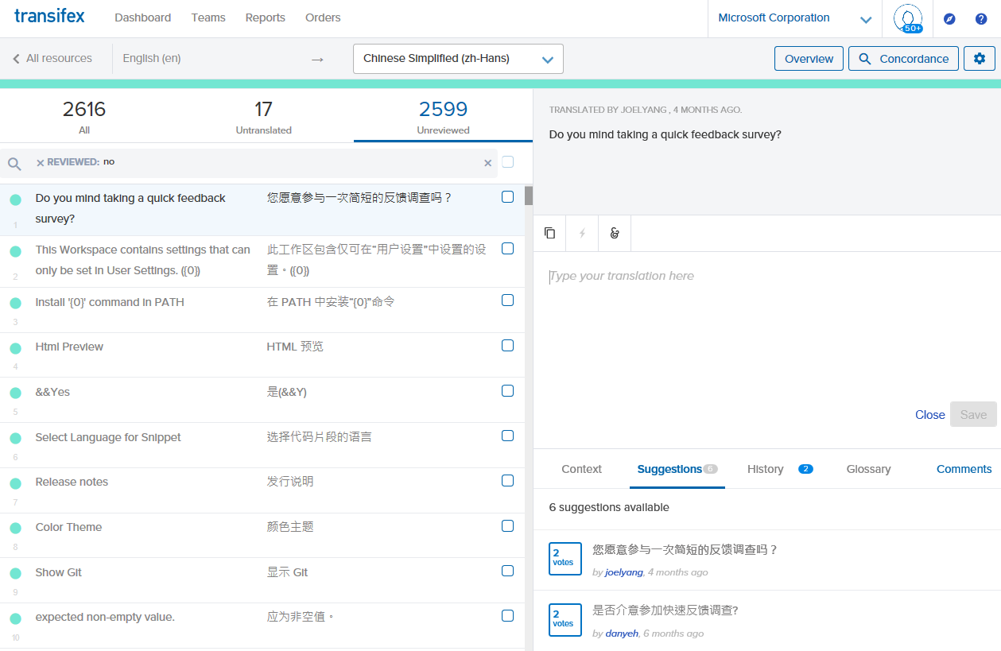
Unreviewed Strings
1. If the string is already translated but Unreviewed, you may still suggest your own translation by typing into the field box or just vote an existing translation suggestions

Slide 14
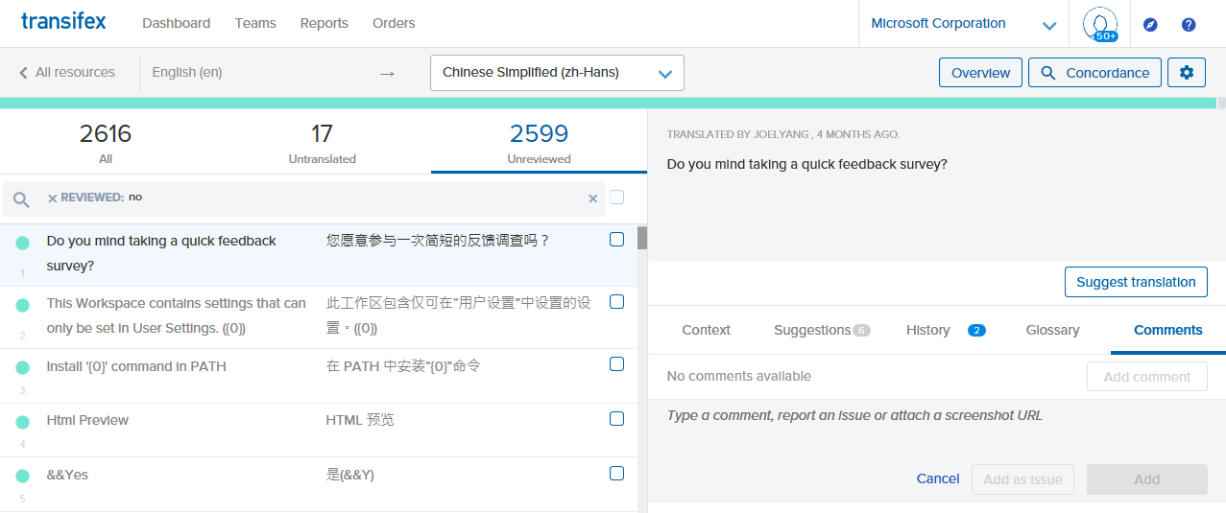
Comments
1. If you have found any issue, you may just add Comments here. Microsoft will respond to you shortly.

Slide 15
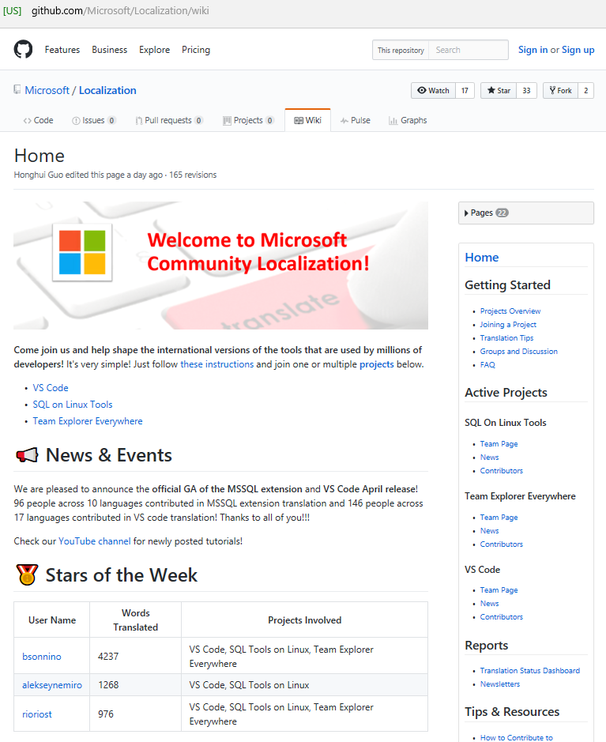
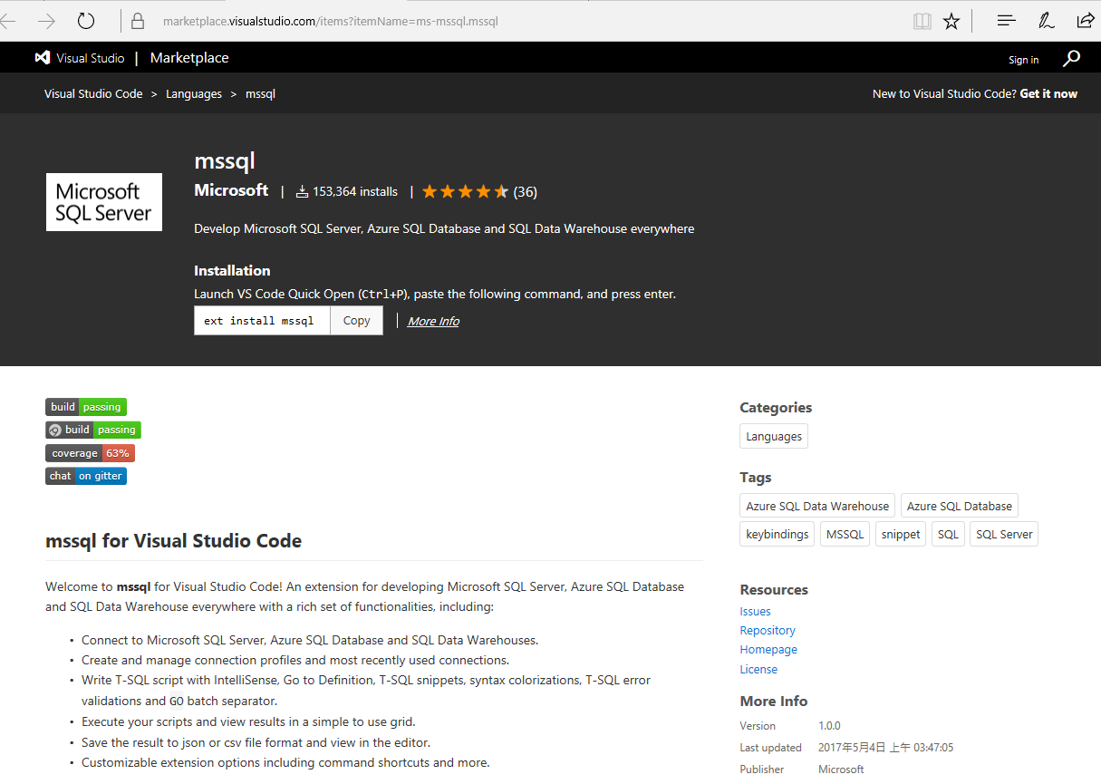
Product Release
Project Status in
https://github.com/Microsoft/Localization/wiki
Localization contribution included in the Release
Contributor’s name in GitHub
Notes:
We just released SQL on Linux Tools (mssql for Visual Studio Code) - https://marketplace.visualstudio.com/items?itemName=ms-mssql.mssql
Contributors are recognized in GitHub page - https://github.com/Microsoft/Localization/wiki

Slide 16
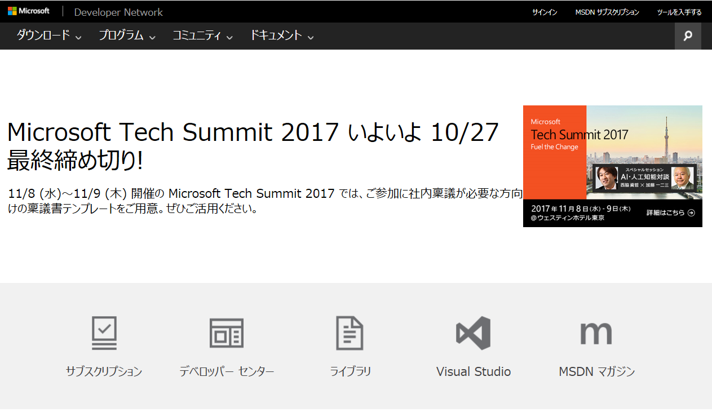
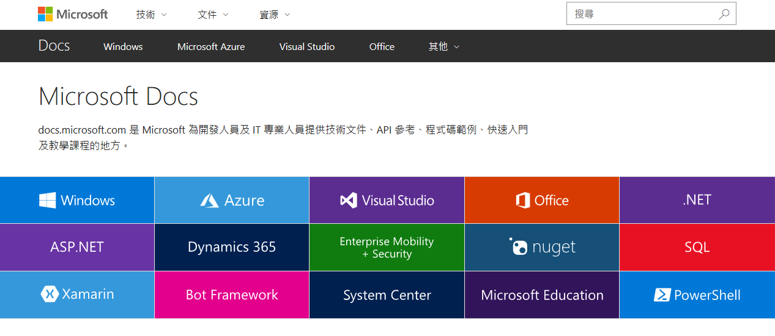
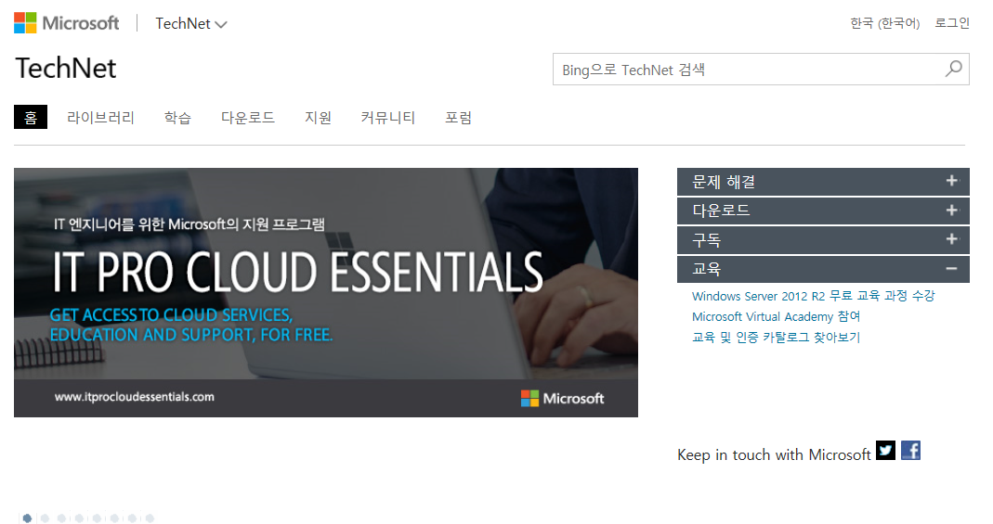
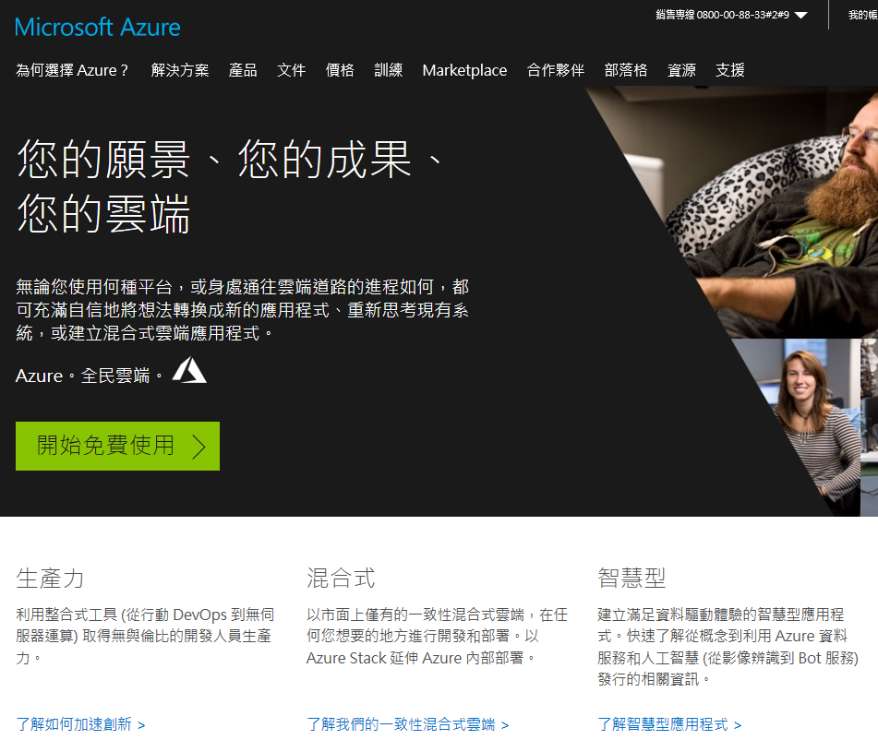
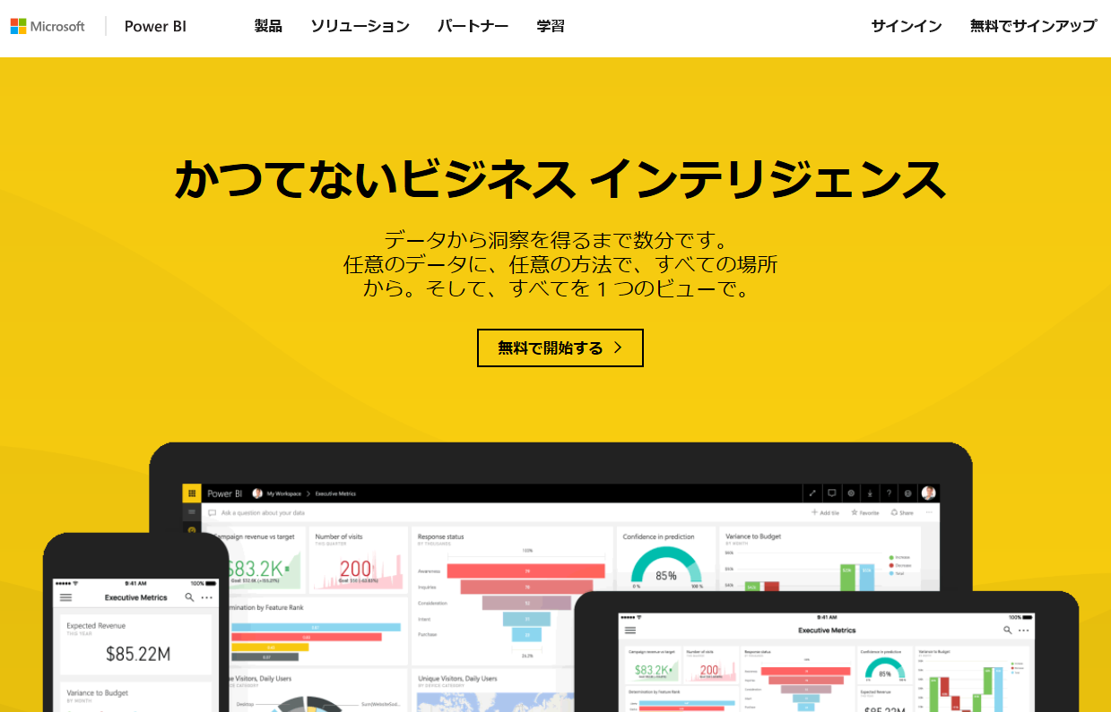
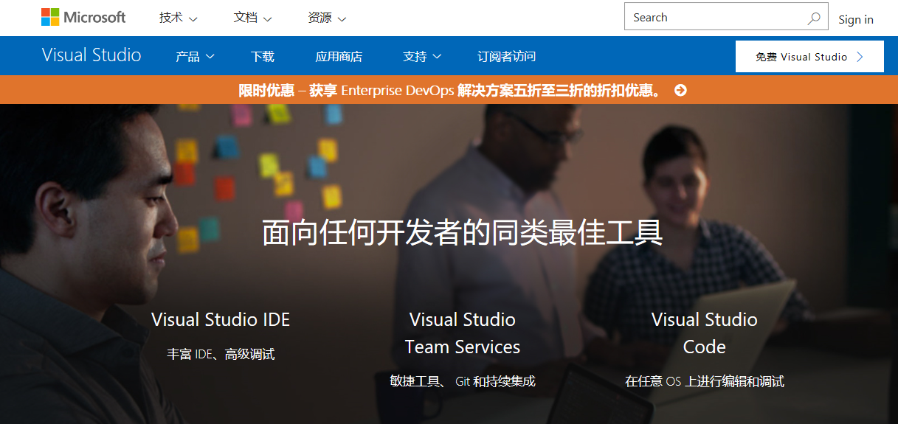
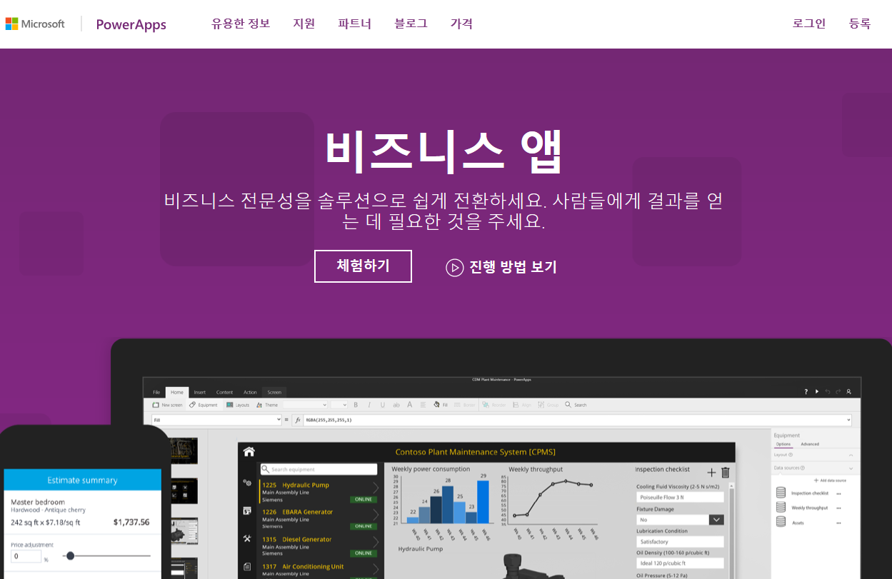
Content Localization
MSDN / TechNet Library are migrating to Docs.Microsoft.Com
We also localize other Microsoft sites

Slide 17
Content Localization Review
Docs.Microsoft.Com
New unified technical documentation experience
Able to edit through GitHub
Reference:
http://aka.ms/docscn (Simplified Chinese)
https://github.com/Microsoft/localization/wiki (English)
Notes:
Scope of Services
Content Localization ($16.2m budget)
Content includes MSDN, Technet, Azure.com, Libraries, DMC, VSO.
Software Localization + Quality ($15M budget)
Software includes SQL, Visual Studio, Azure, System Center, Identify & Security solutions, Intune, Power BI, Machine Learning, Cognitive Services and many interconnected pieces that touch Office and Windows
Tools and Services
We are continuing to work with our vendors to improve and catalog machine translated language libraries to optimize our future localization efforts.
Note: Dynamics & CRM localization is handled by a separate team

Slide 18
How to Edit Docs?

Slide 19
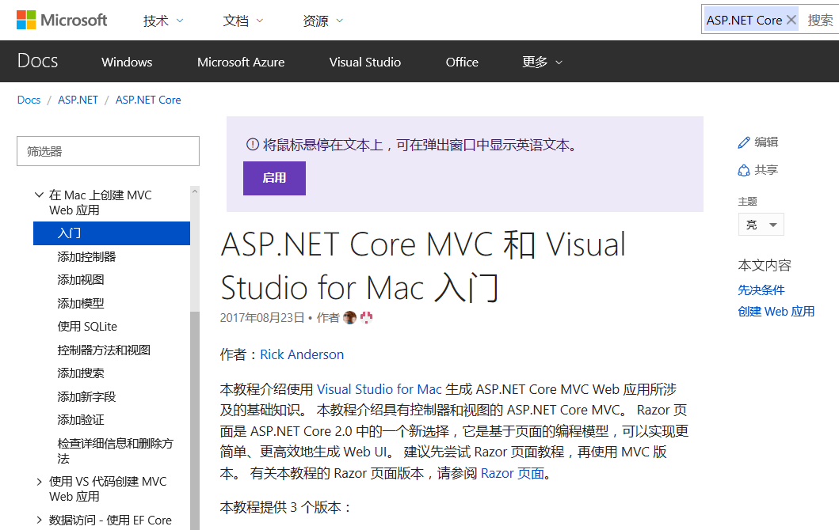
Opportunity for Community
1. Any page with Edit link is available to be edited by any GitHub users
2. Contributors of the page are listed

Slide 20
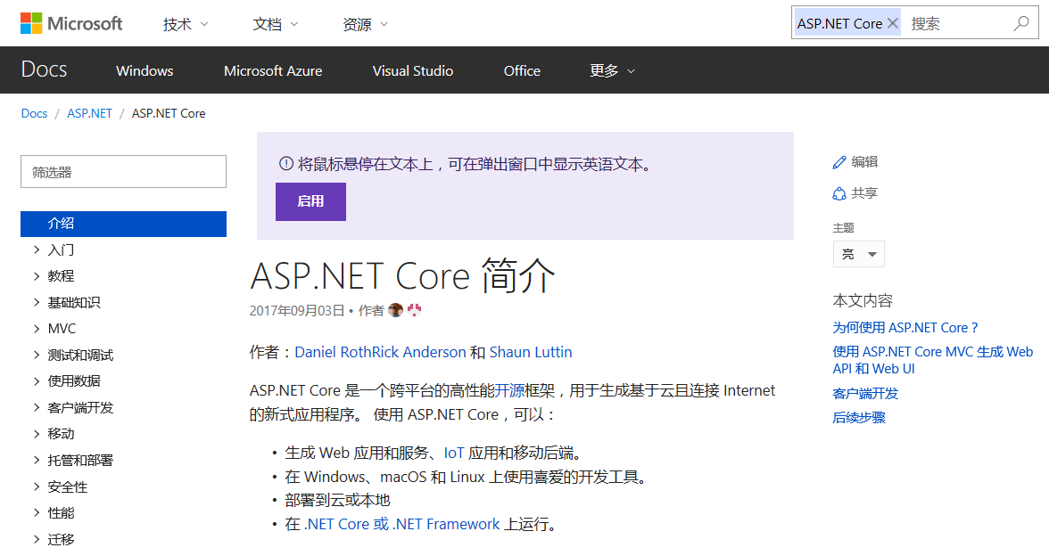
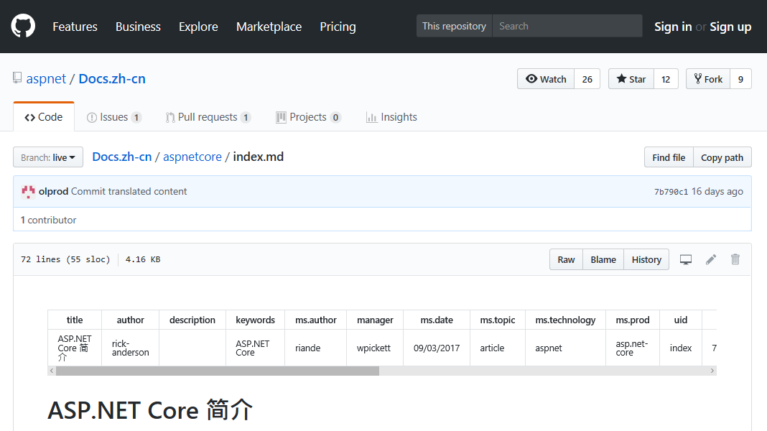
Sign in GitHub
1. Click the Edit link
2. It brings you to GitHub page
3. Click Sign in if you already have a GitHub account, otherwise, click Sign up

Slide 21
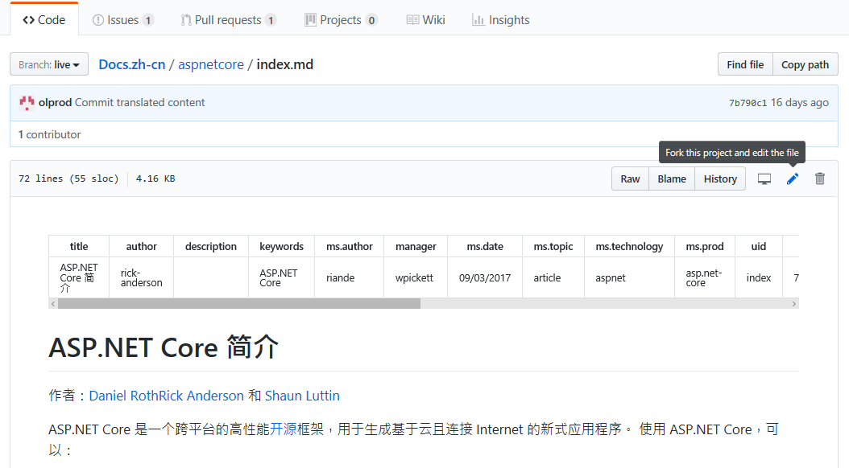
Edit the Page
1. Click to fork this project and edit the file
2. You may edit the text

Slide 22
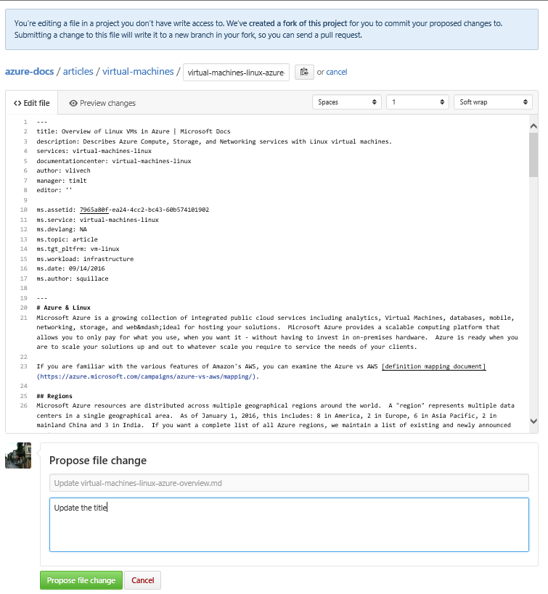
Propose the Change
1. Upon finishing editing, click the Propose File Change button

Slide 23
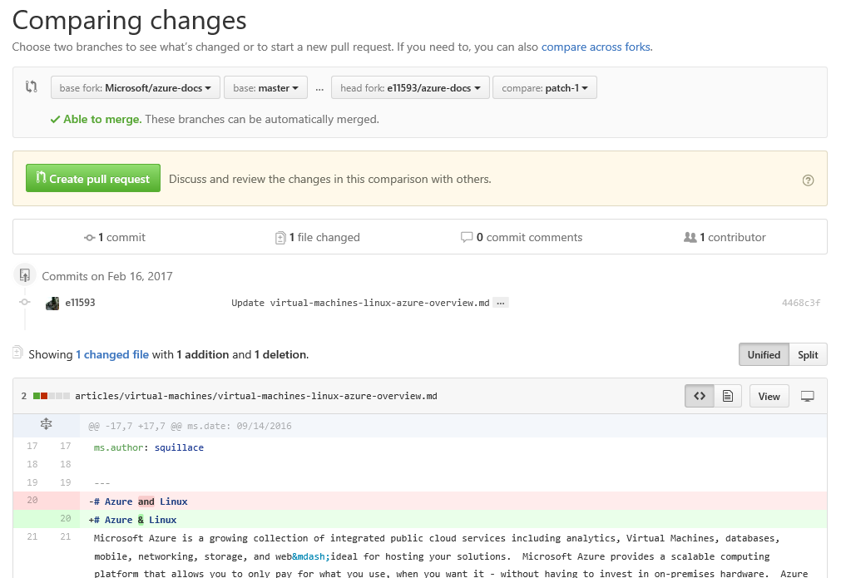
Create Pull Request
1. Click Create Pull Request once you have confirmed the change and the it will be reflected in the live site once it is approved by moderator
2. It shows the changes you have made

Slide 24
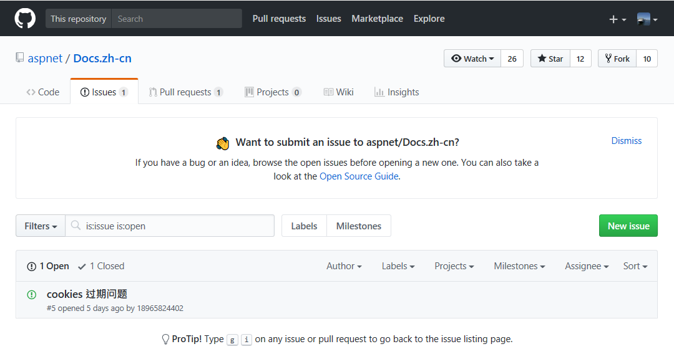
Create Issues
1. Click Issue page if you have a bug or an idea
2. Microsoft will respond to you after the New Issue is created

Slide 25
Hack-a-Docs
Gain awareness of Docs
Improve content quality through Community review and contribution
Complement and enrich the content of Microsoft product
Machine Learning Training
Build Localization Community
Increase Azure and other Microsoft product users as ultimate goal
Reference:
https://github.com/Microsoft/Localization/wiki/What's-a-HackADoc (English)

Slide 26
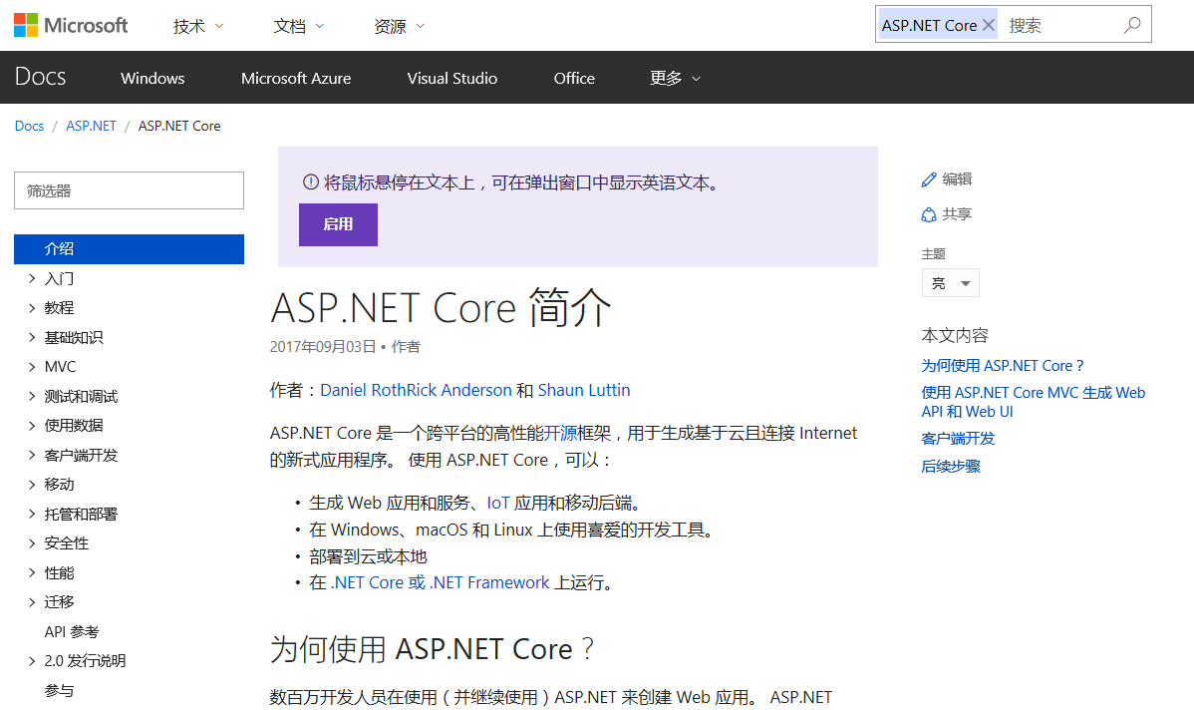
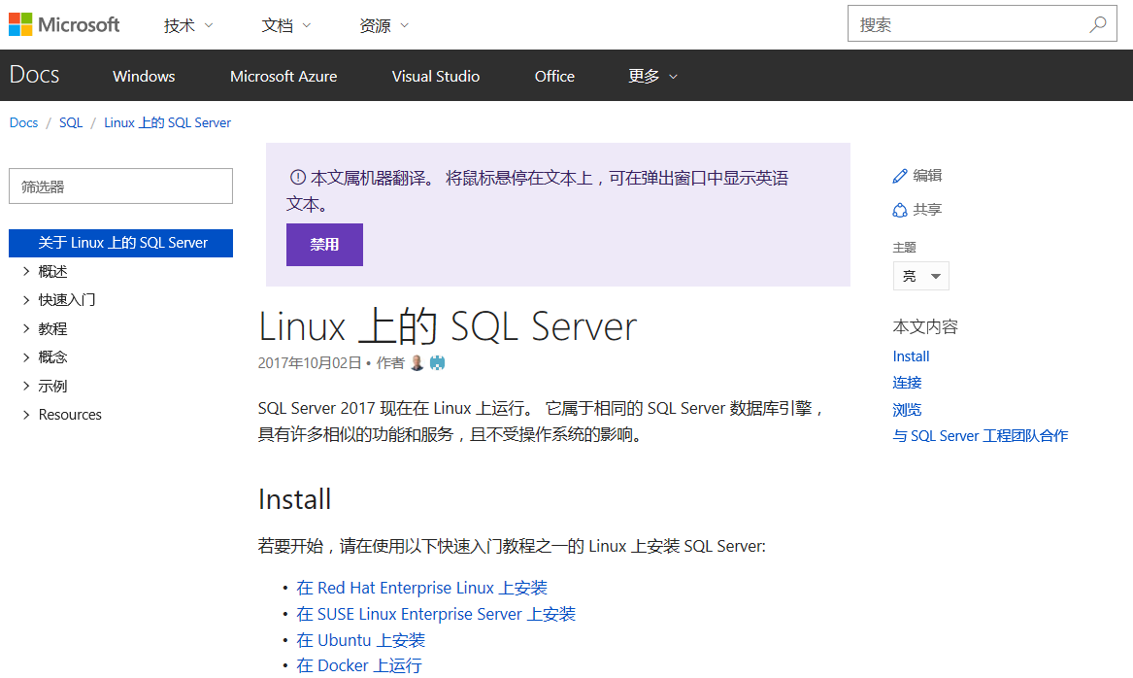
SQL on Linux & ASP.NET Core
Timeline:
Oct 21, 2017 – Nov 21, 2017
Focus:
We will focus on the pages under:
https://docs.microsoft.com/zh-cn/aspnet/core/
https://docs.microsoft.com/zh-cn/sql/linux/
Requirement:
Participants should have GitHub account.
1. Other preferred topics?
2. Please let me know your GitHub account to track the contributions
Notes:
https://docs.microsoft.com/en-us/aspnet/core/
https://docs.microsoft.com/en-us/sql/linux/

Slide 27
Rules
Activity | Description | Points
# submissions | For each submission/pull request entered (Any Pull Requests generated through GitHub will be tracked) | +10
# accepted submissions | For each submission/pull request that gets accepted and implemented (We have a team to review all the contributions from communities) | +100
# content errors in original article | If you find a technical error in the original (source) article and your suggestion gets accepted (in addition to being counted as an accepted contribution) (If the participant’s request is not related to the translation, but the original content, we will also accept it) | +100
# referrals | If you have at least an accepted submission, you receive extra points for referring other active contributors (active == those that will have at least one accepted submission) (We also welcome you to invite your friends to contribute to Docs. Please tell us your friend’s GitHub ID; so that we may verify. If your friend has contributed to Docs, we will add you points for the succesful referral) | +100
Notes:
Leaderboard will be available

Slide 28
Contact
Terry Sheng
Email - tesheng@Microsoft.com
Wechat ID – MicrosoftL10n
Notes:
Do you have the actual page which shows top contributors? If possible, I’d like to provide the actual page to MVPs and communities for reference to encourage them to join the campaign.

